Slide 1


Jump Statements in C Language
Jump statements are an important part of C language that allows you to control the flow of your program. In this presentation, we will explore the different types of jump statements and how to use them.

Slide 2


What are Jump Statements?
A Definition
Importance of Jump Statements
Jump statements are statements in C language that cause the program execution to immediately jump to another section of code.
Jump statements are important because they allow you to improve the efficiency of your program and make your code more readable by controlling the flow of your program.

Slide 3
Types of Jump Statements
Break Statement
Continue Statement
The break statement is used to exit the loop when a certain condition is met.
The continue statement is used to skip a certain iteration of a loop when a certain condition is met.
Goto Statement
Return Statement
The goto statement is used to transfer the control of the program to a specific labeled statement within the same function.
The return statement is used to exit a function and return a value to the calling function.

Slide 4

Examples of Jump Statements in C
1
Example 1
The break statement in a loop.
2
Example 2
The continue statement in a loop.
3
Example 3
The goto statement in a function.

Slide 5
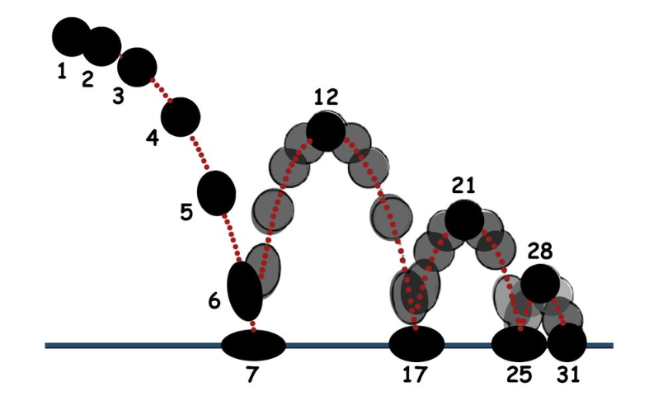
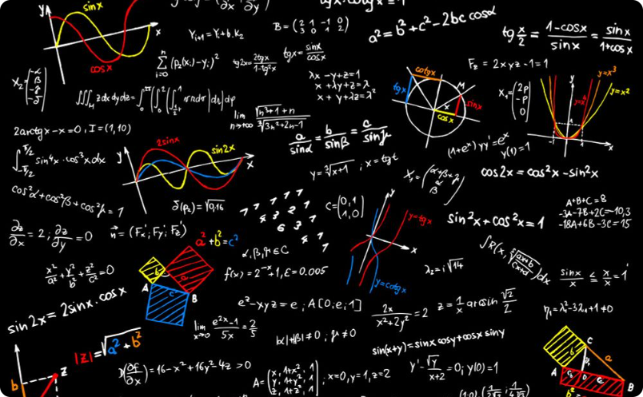
Benefits of Jump Statements in C
Increased Control and Flexibility in Program Flow
Simplified Coding for Conditional Statements
Jump statements allow you to control the flow of your program more efficiently, taking advantage of controlled exit points and targeted re-entry points.
Jump statements can simplify coding for conditional statements, making your code more readable and easier to follow.

Slide 6

Conclusion
1
Jump statements provide increased control over program flow.
2
They simplify coding for conditional statements.
3
Understanding the different types of jump statements and how to use them can help you write more efficient and readable code.

